Slide 1
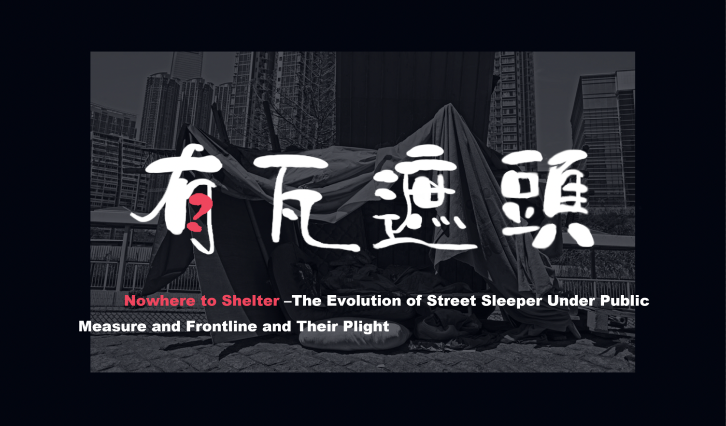

Slide 2
01
Background
Agenda
02
Data processing
03
Data analysis
- 3.1 The background of Public policy - 3.2 The frontline of public measures - 3.3 The plight of street sleepers

Slide 3

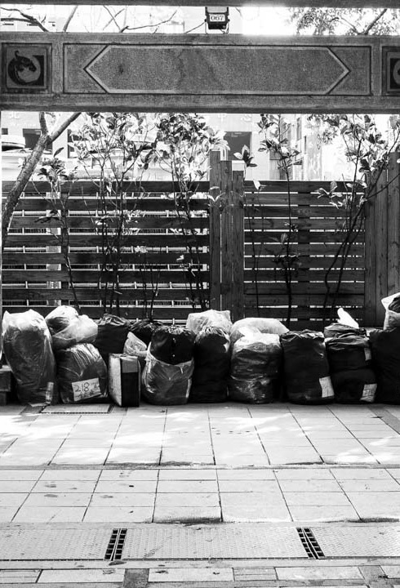
01
Backgroud

Slide 4
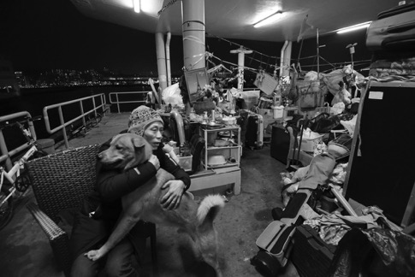
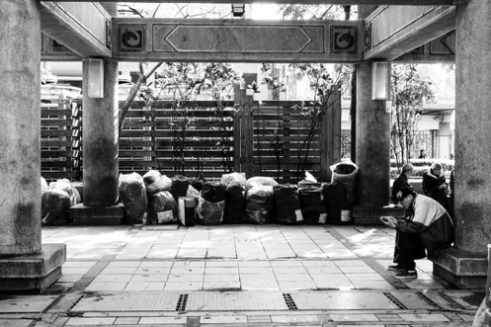
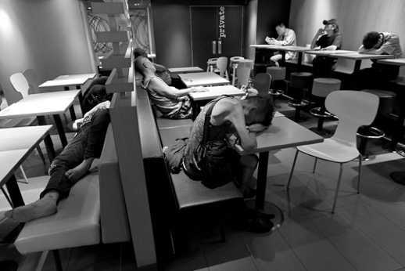
Until now, “有瓦遮頭” is still a luxury for some people. Official statistics show that the number of street sleepers in Hong Kong doubled from 787 in 2014 to 1,562 in 2021. Because of the government's official data is based on voluntary registration of street sleepers, it also means that the size of this group is larger than we thought.
01 Background

Slide 5
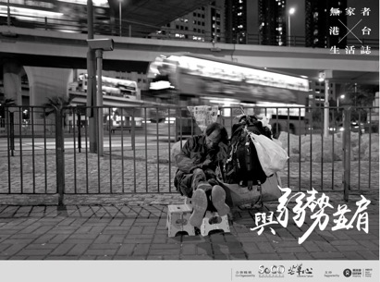
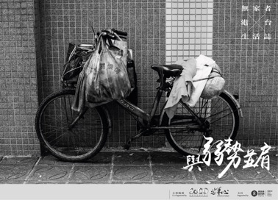
01 Background
The issue of street sleepers has been discussed and concern since the establishment of the Hong Kong government in 1841. Every year, the government promotes a social survey of the real situation of street sleepers, establishes relevant assistance departments and measures, and introduces a series of policies for caring for street sleepers...
However, in the past 70 years, Hong Kong has developed into a world-class city and Asia's financial center, and the situation of such groups has not been fundamentally improved.
Instead, it has become more and more difficult.

Slide 6
Our project aims to compare the topics and keywords of the Hong Kong Legislative Council Street Sleepers Conference from 1997 to 2021, and find out why the series of measures promulgated and implemented by the Hong Kong government over the years have not only failed to reduce the number of street sleepers, but also have deepened their survival plight.
01 Background
Core issue

Slide 7
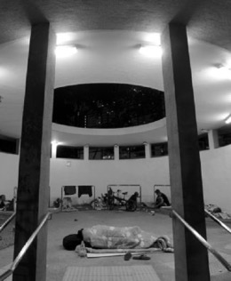
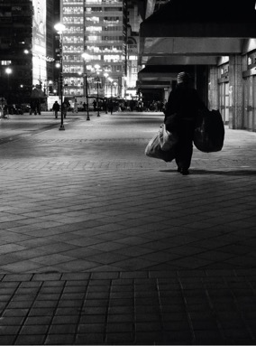
Why it is important?
01 Background
In Hong Kong, many people were college students, businessmen, decent jobs, happy families before becoming street sleepers... … But after experiencing something that could not be surpassed in a short period of time, they had to choose to become street sleepers.
-Therefore, everyone is likely to become street sleepers, so such groups cannot always be marginalized by society, or even regarded as existences that should not exist.
-The government's measures should provide these groups with the most needed help, so that "有瓦遮頭" is no longer just a slogan.

Slide 8

Research Question
1.In 1997-2021, what are the topics and keywords discussed in the Hong Kong Legislative Council on the street sleeper policy each year?
2.Do these topics and keywords have certain similarities?
3.How are these similarities reflected in the specific policy implementation level and the actual living environment of street sleepers?
4.Why did the government's policy from 1997 to 2021 not reduce the number of street sleepers and improve the survival plight of street sleepers?

Slide 9
01
Data sources
Data processing
02
Data cleaning
03
TF - IDF
02

Slide 10

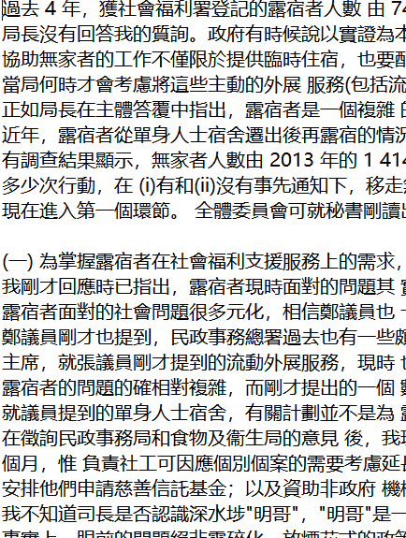
Data sources
Legislative Council Documents(1997-2021)
https://www.legco.gov.hk/
* Codebook note
The variables meaning: Legislative Council Documents discussing about street sleepers
Coding protocol: Copy and paste the original text.

Slide 11
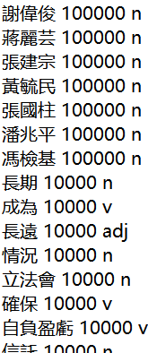
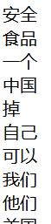
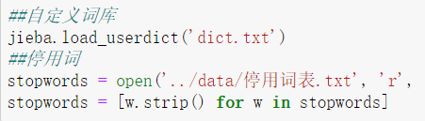
Data cleaning
Filter the original text file
dict
停用词表
* Code note: ‘dict.txt’ is from user-defined dictionary; ‘停用词表.txt’ is from Chinese stop words dictionary.

Slide 12
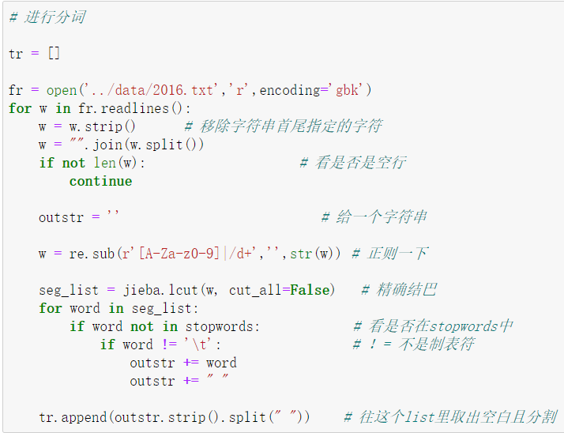
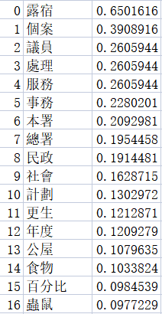
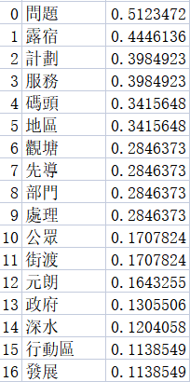
TF - IDF
Word segmentation
Save as CSV files
TF -IDF

Slide 13
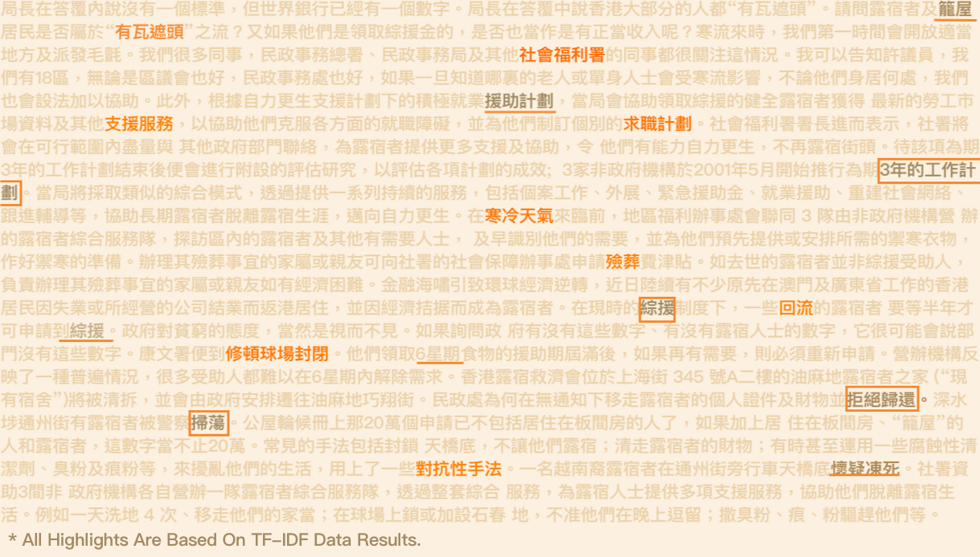

Slide 14
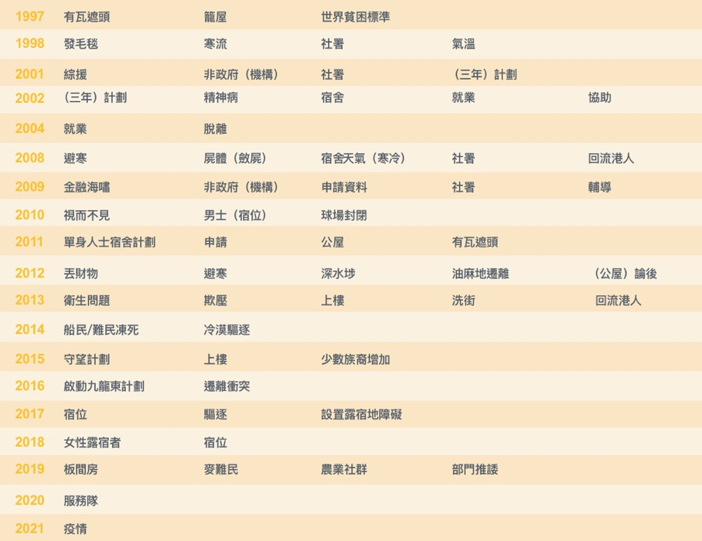
Discussion topics from 1997 to 2021.
* Based on the results of the TF-IDF analysis.
We categorize the topics for each year by eye tracking and conclude structural discussion topics from 1997 to 2021.

Slide 15
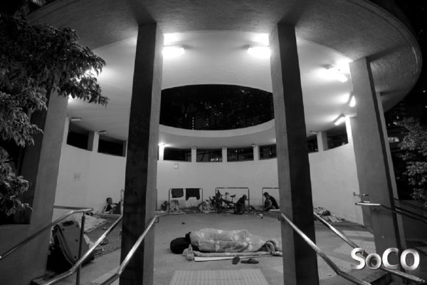
03
Data analysis

Slide 16
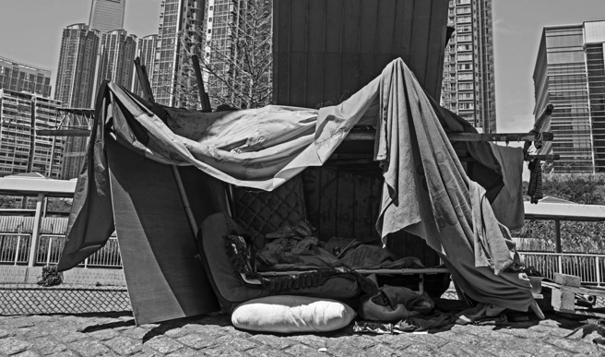
3.1
“有瓦遮頭”
The background of Public Policy
What policies has the HKSAR government put forward regarding street sleepers?
What does each policy involve?
Does Three-year action policy and Project R policy involve similarity?

Slide 17
Policy Timeline
2001.4-2004.3
2018-
Three Year Action Plan
Urban Hostel for Single Persons
2014.8-2015.12
Project R

Slide 18
Policy overview
Time | Policy | Policy Abstract
2001.4-2004.3 | “Three Year Action Plan” | The service units participating in the work plan provide a series of continuous services to street sleepers, including casework, outreach, emergency and short-term accommodation, emergency assistance, employment assistance, social network reconstruction and follow-up counseling, etc.
2014.8-2015.12 | Project R | The " Project R" is dedicated to social workers to understand and follow up street sleepers. The social association arranges various training programs, including improving work desire and skills, to help them escape from street sleepers. Community members also provide additional support, such as arranging referral work.
2018- | Urban Hostel for Single Persons | The Administration emphasized that the Single Person Hostel Scheme is not a housing or welfare scheme for street sleepers, and it has never been used for this purpose. If street sleepers have real and urgent needs for housing and welfare and cannot solve the problem on their own, the SWD and the Housing Department will provide assistance in accordance with their respective policies.

Slide 19
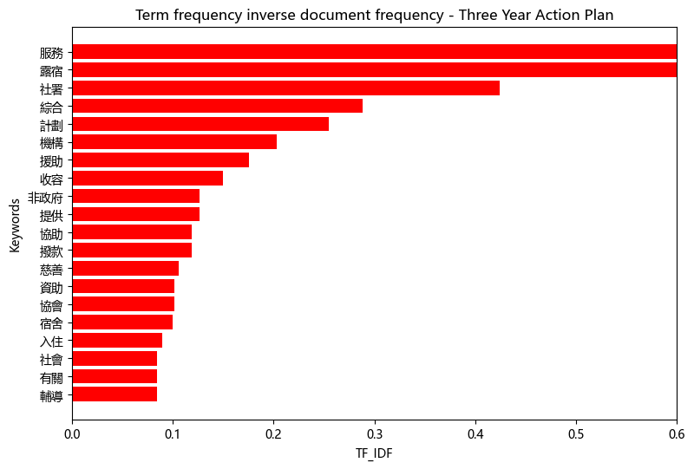

What does Three Year Action Plan policy involve?

Slide 20
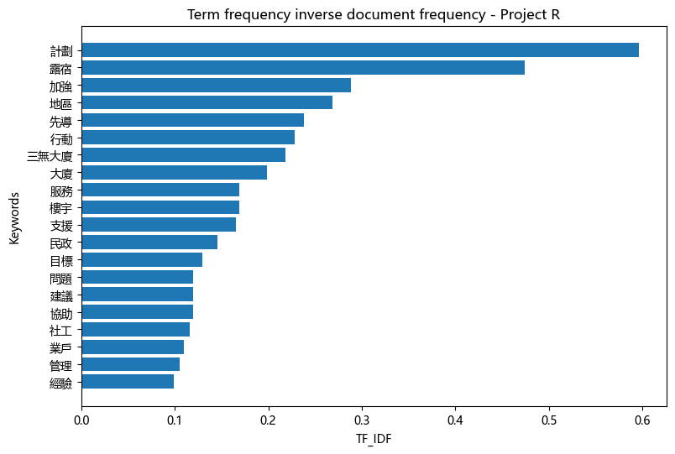

What does Project R policy involve?

Slide 21
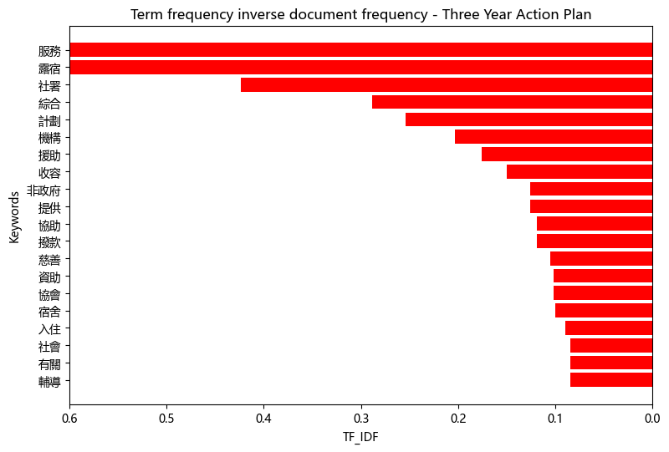
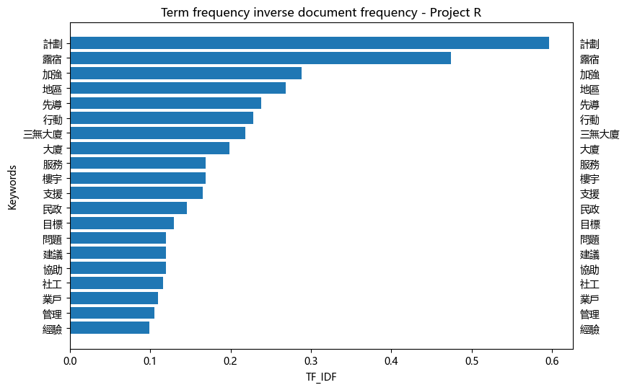
Does Three-year action policy and Project R policy involve similarity?

Slide 22
What we find?
Three-year action plan refers to many keywords including Street Sleepers Integrated Service Team, social welfare department (SWD), Grants, dormitories, counseling and etc. Project R refer to many regional plans especially for Sham Shui Po District, and keywords including Buildings, business owners, social workers.
According to Sham Shui Po districts strengthen the district administration pilot R program, it is about maintain close liaison with the groups serving street sleepers in the district, and contact the district’s enthusiastic people and organizations to provide extra support for street sleepers.

Slide 23
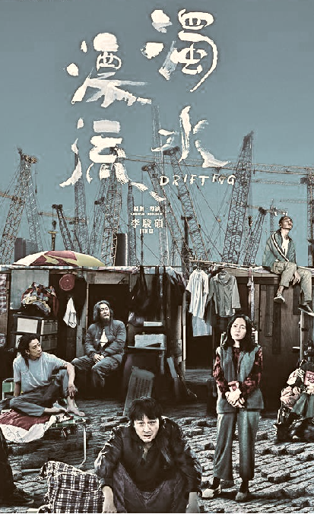
3.2
冇瓦遮頭
The Frontline of public measures

Slide 24
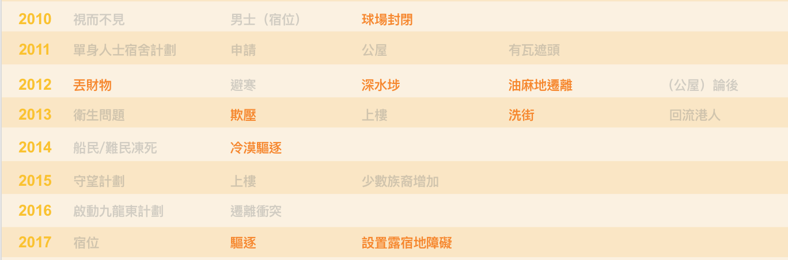
Mentions about government’s unfriendly actions

Slide 25
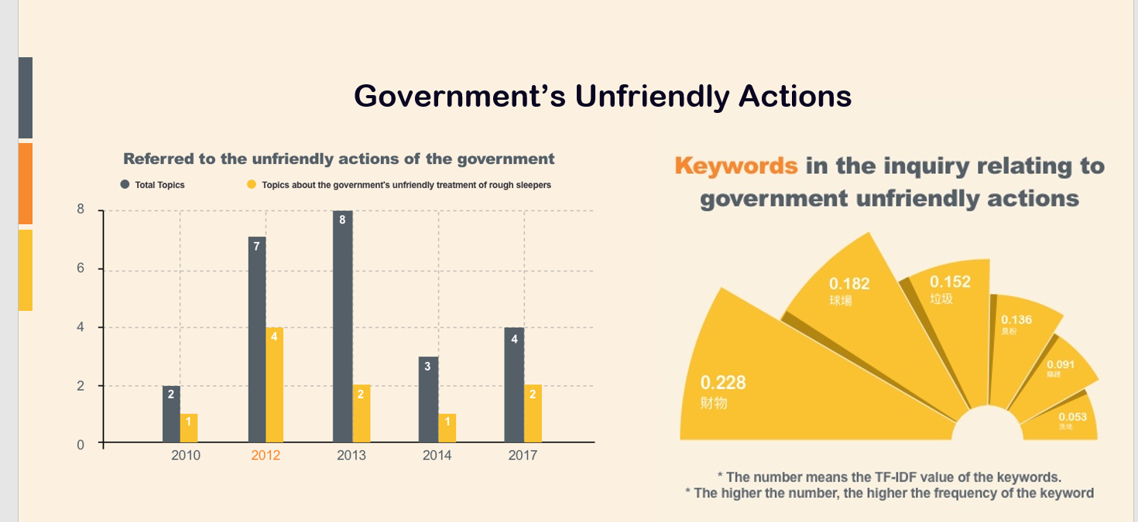
Government’s Unfriendly Actions

Slide 26
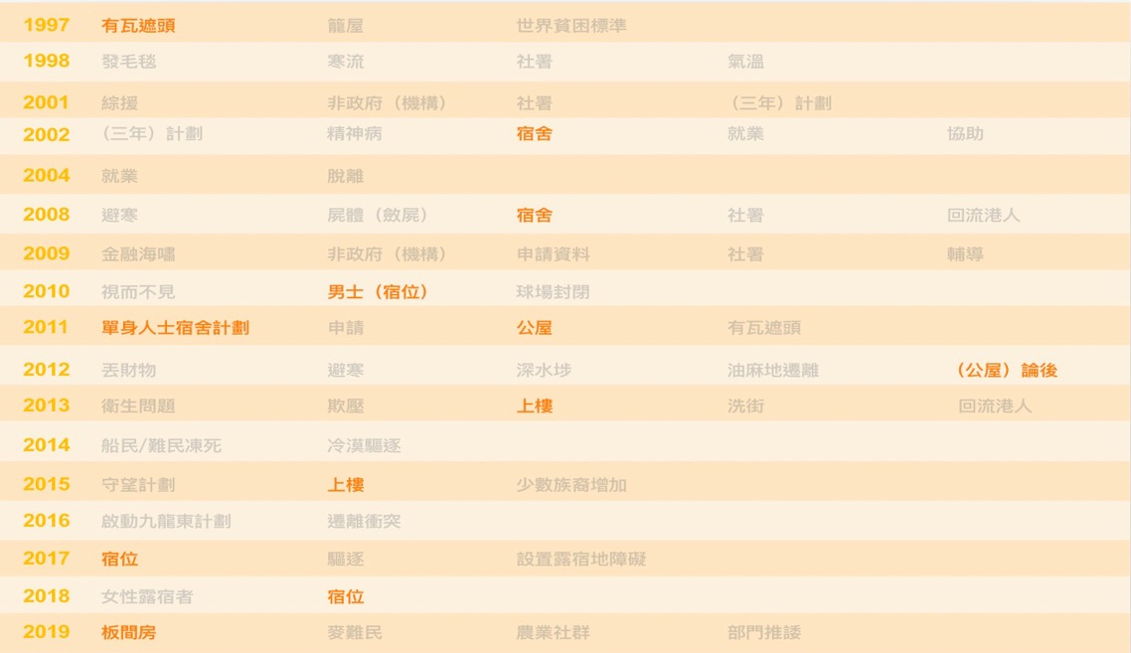
Mentions about accommodations

Slide 27
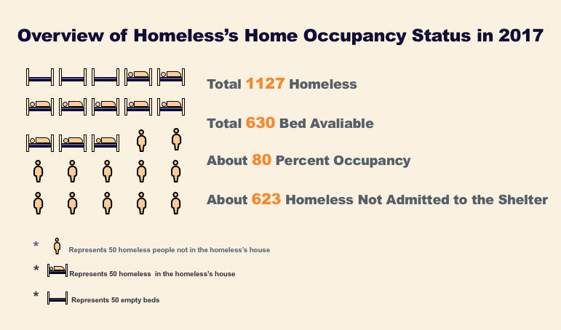

Slide 28
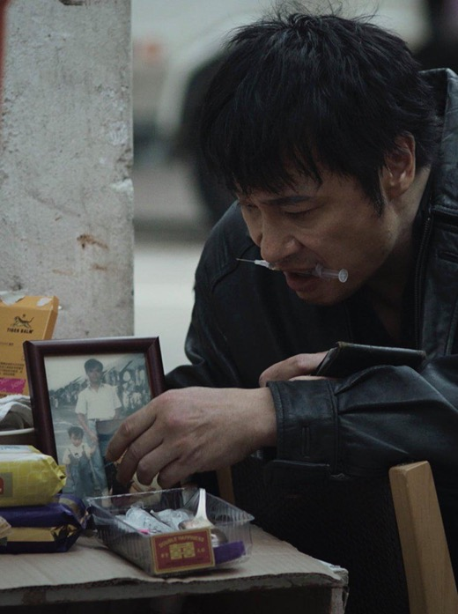
3.3
瓦喺边度？
The plight of street sleepers

Slide 29
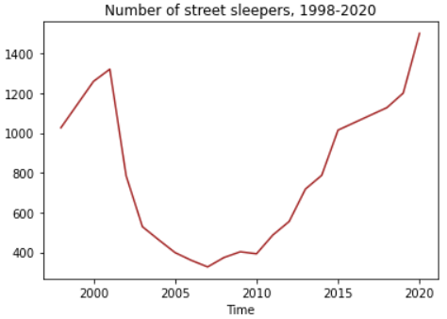
The plight of street sleeprs
Inflection point ：2007
The number of street sleepers keeps increasing from 374 in 2008 to 1,500 in 2020

Slide 30
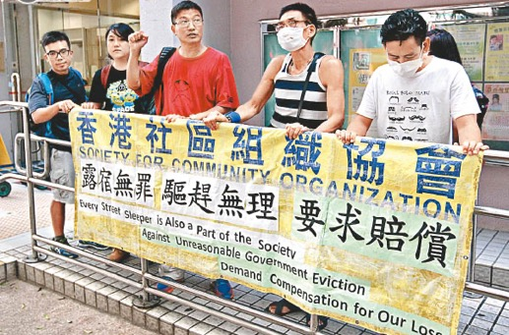
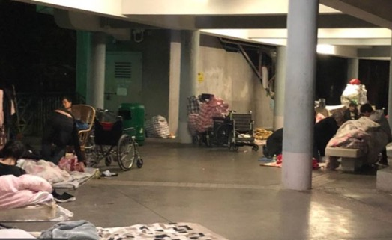
The plight of street sleepers
Basic rights?
No legislation or policy to protect the basic rights of street sleeprs in Hong Kong
Health?
During COVID-19,
street sleepers are not eligible for temporary shelters

Slide 31
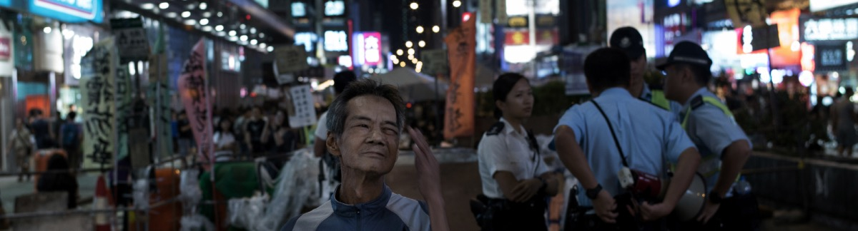

The government must stop the violent evictions and develop homeless-friendly policies to address their basic needs such as housing, mental health, work and socialization.

Slide 32
References
影像：首個港台露宿者攝影展 細說兩地街友的無家困境 (https://theinitium.com/article/20190429-photo-homeless/)
全港無家者人口統計調查2021調查簡要報告 (https://soco.org.hk/rp20211026/)
新冠肺炎疫情對非綜援無家者的影響研究 2020 (https://soco.org.hk/pr20200510-4/)
SOCO 香港社區組織協會 (https://soco.org.hk/)
香港立法會 (https://www.legco.gov.hk/)

Slide 33





Team members _echo
YANG Xuzhen
-- So-called leader
HU Xuanyu
-- I’m not bald yet!
LIANG Tong
-- I closed myself off!
FU Lanying
-- Yes, I got over it!

